Slide 1
Codeacademy: Python Biodiversity Project
Jason Britton
10APR2018

Slide 2
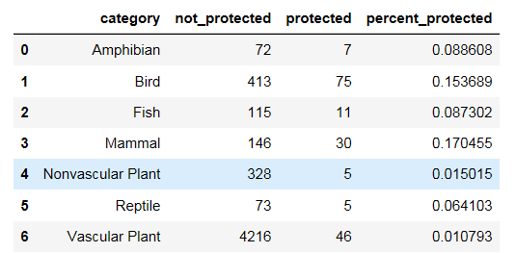
Species Database Information Description
It is interesting to note the number of species monitored versus the number of species that have some sort of protected status; approximately 3.0%. This begs the question, are there species that have not been identified that are not included in the census or are not considered vital enough to monitor? How might this information impact that analysis? Why were the species chosen? There is a need to determine the parameters of the Species Database to further ensure the legitimacy of any statistical analysis.
The percent protected also shows an interesting dynamic in that the percent of protected species increases as category value progresses higher through the food chain, relatively speaking. For example, plants have the lowest percent of protected species; reptiles, amphibians and fish mark the gradation; while mammals and birds have the greatest percentage of protected species.
This observation could be useful in determining overall causes for species decline when taken into consideration with other significant factors.

Slide 3
Significant Calculations
After conducting the significance calculations, it is apparent based on the p-values that mammals and birds do not have statistically significant differences in the number of protected species between the two groups.
However, when comparing mammals and reptiles, the p-value (0.038) shows that we cannot reject the null hypothesis and that there is a statistically significant difference between the number of protected species between the two groups.
Other significance calculations provide interesting results as well. For example, the difference between protected species of vascular and non-vascular plants does not seem to be statistically significant (p-value = 0.66), while the difference between mammals and vascular plants is very significant (p-value = 1.44e-55). Based on this result, it would be interesting to see if the protected vascular plant species comprise a significant portion of the protected herbivorous mammals’ diet.

Slide 4
Recommendations
It is my opinion that further analysis needs to be conducted before recommendations are made. While the difference between protected mammal species and protected reptile species is statistically significant, current analysis did not identify ecologically significant characteristics of the protected mammal species. For instance, are these species small mammals that represent substantial contribution to reptile diets? Are the mammals herbivores whose diet consists mainly of protected vascular plants?
Further analysis into these questions would help focus recommendations for conservation efforts to pinpoint critical areas that may impact all protected species and avoid creating issues that jeopardize other species.

Slide 5
Sample Size Determination: Foot and Mouth Disease
Based on the sample size determination calculations, researchers would need to observe the sheep at Bryce National Park for approximately two weeks.
In addition, sample size determination calculations indicate that researchers interested in foot and mouth disease in Yellowstone National Park would only need to observe the population for approximately one week.

Slide 6
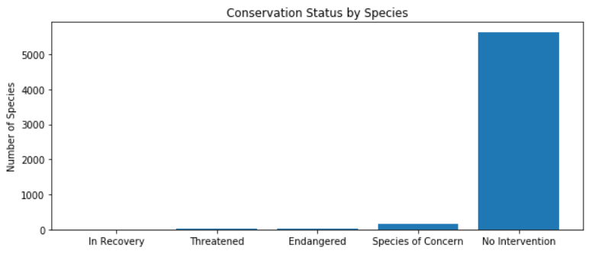
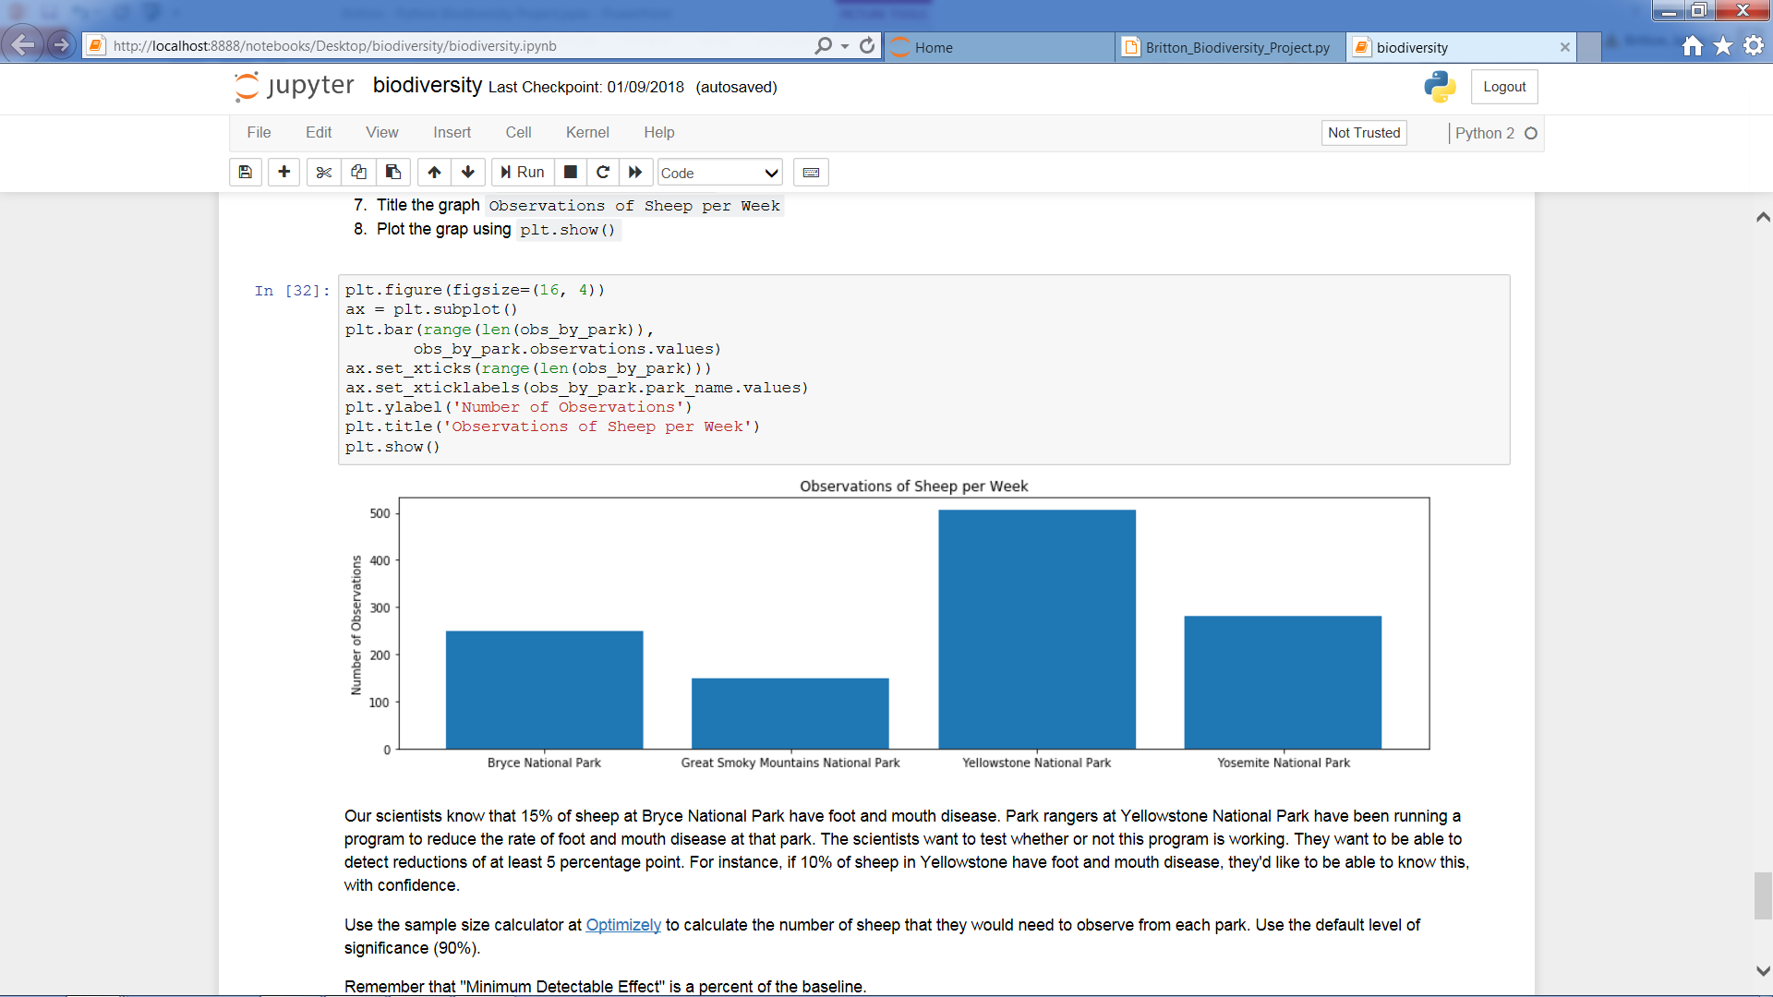
Graphical Analysis

Slide 7
Python Biodiversity Project Code Academy: Introduction to Data Analysis Python Biodiversity Project Jason Britton 10APR2018

